Slide 1
D205 Data Acquisition, Performance Assessment
Alexa Fisher
Western Governors University
Master of Science Data Analytics

Slide 2
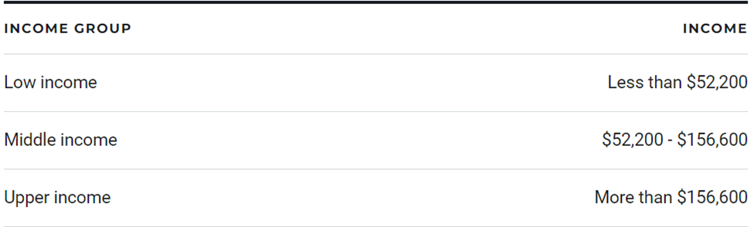
Research Question:
How many customers selected the internet service ‘Fiber Optic’ for each economic income class per state?
American Economic Class System by Pew Research Center
Availability per State
Table 1: Economic Class System based on Income (Snider,2021).

Slide 3
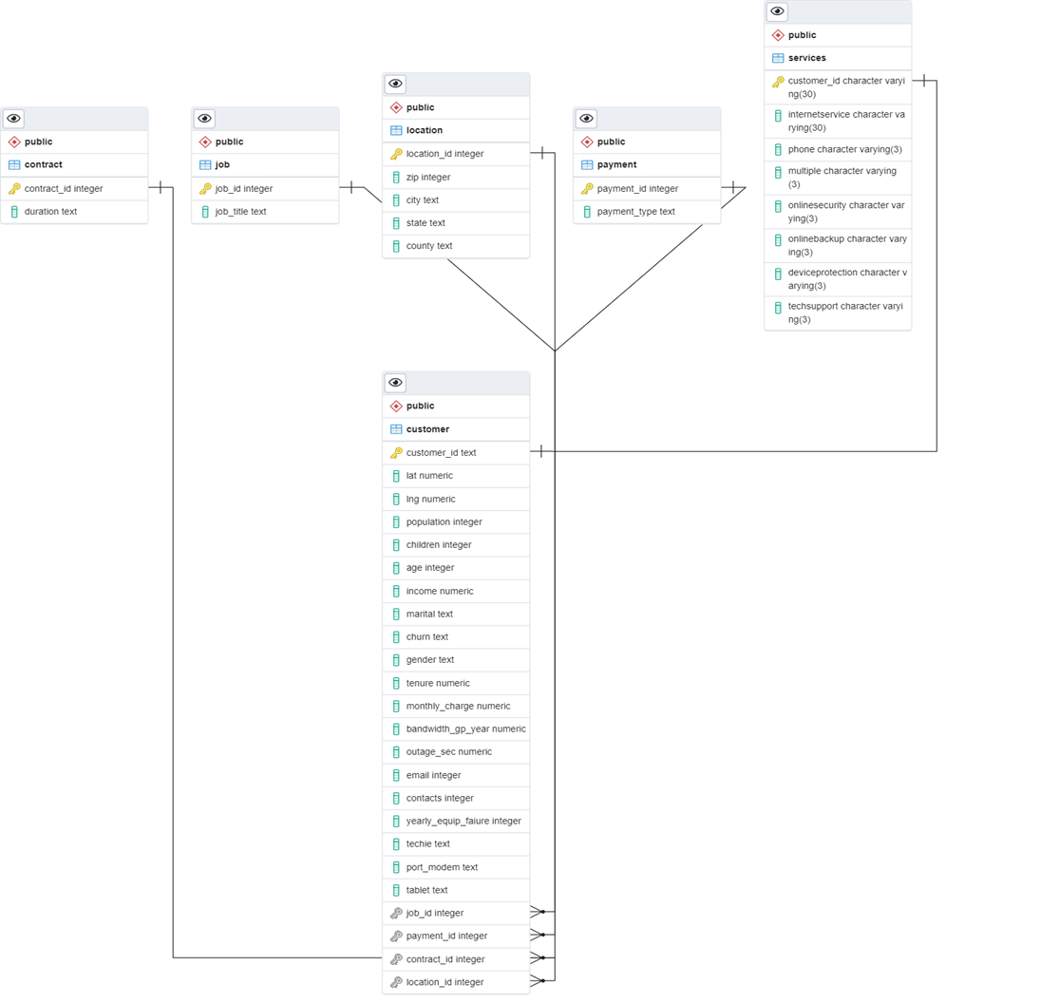
Table | Attribute
customer | customer_id
customer | children
customer | income
customer | location_id
customer | marital
location | location_id
location | state
services | customer_id
services | internetservice

Slide 4
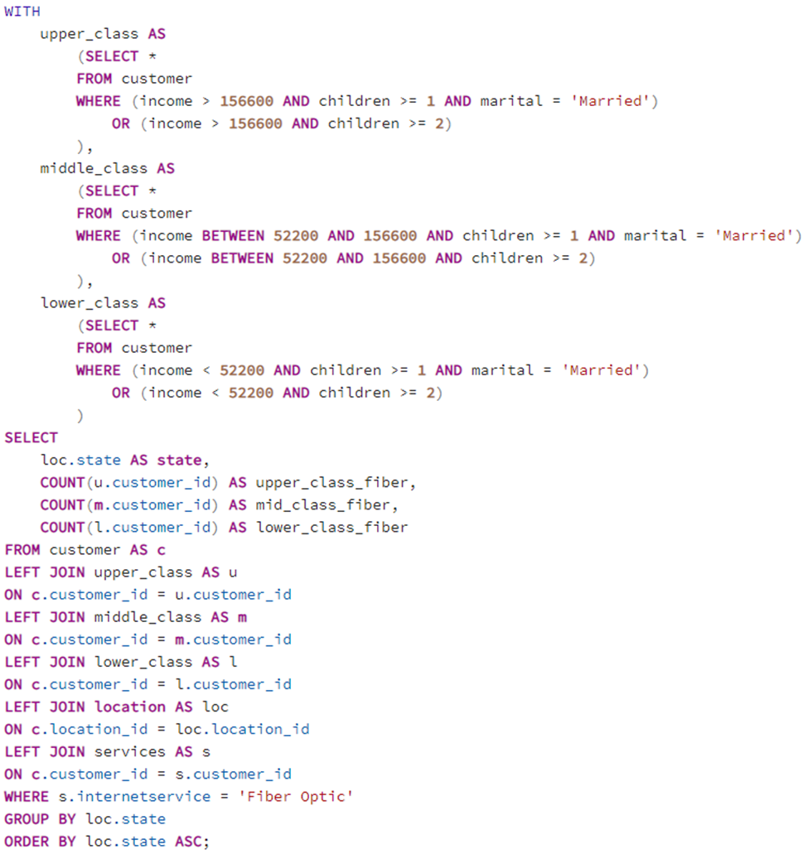

Slide 5
Refreshing the Data
New data added to the customer data set.
Annual organizational analysis

